Slide 1
FEE REPORT
Submitted By
P.INIYA
Batch No:2021-6334

Slide 2
ABSTRACT
The concept is based on the GUI (Graphical User Interface)
The idea is to use Java Swing and AWT (Abstract Window Toolkit)
Therefore , we need to define all the methods based on functionality

Slide 3

OUTPUT FORM

Slide 4
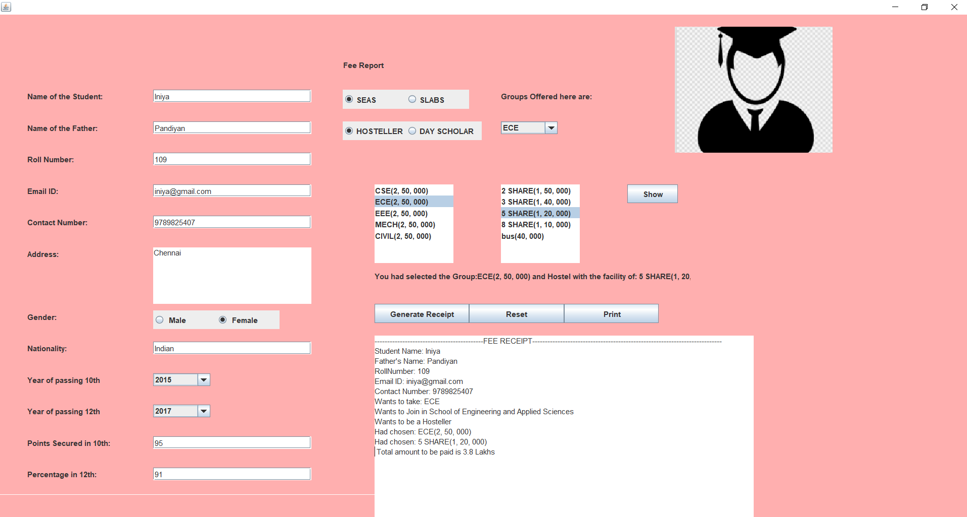

Slide 5
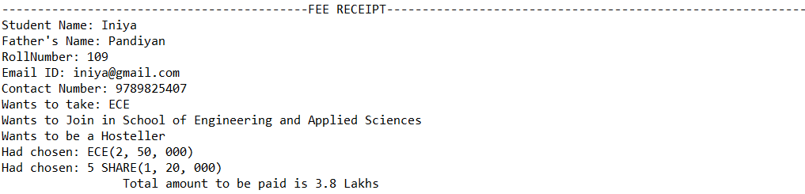
FEE RECEIPT

Slide 6
THANK YOU

